Slide 1

health-hub
DBMS Project
Ishita Garg 102203992
Akshita Pathak 102203796
Ayushi Rathore 102203816
Aarushi Bajaj 102203820

Slide 2
contents
1. Introduction
2.ER Diagram
3. Database Structure
4. SQL Statements and PL/SQL Code
5. System Usage Scenarios
6. Conclusion
7. References

Slide 3
introduction
Purpose:
Create a robust software application to manage doctor- patient interactions efficiently.
Scope:
Applicable in hospitals, clinics, and private practices.
Implementation:
Implemented using a comprehensive database to handle all relevant data for managing healthcare services.

Slide 4
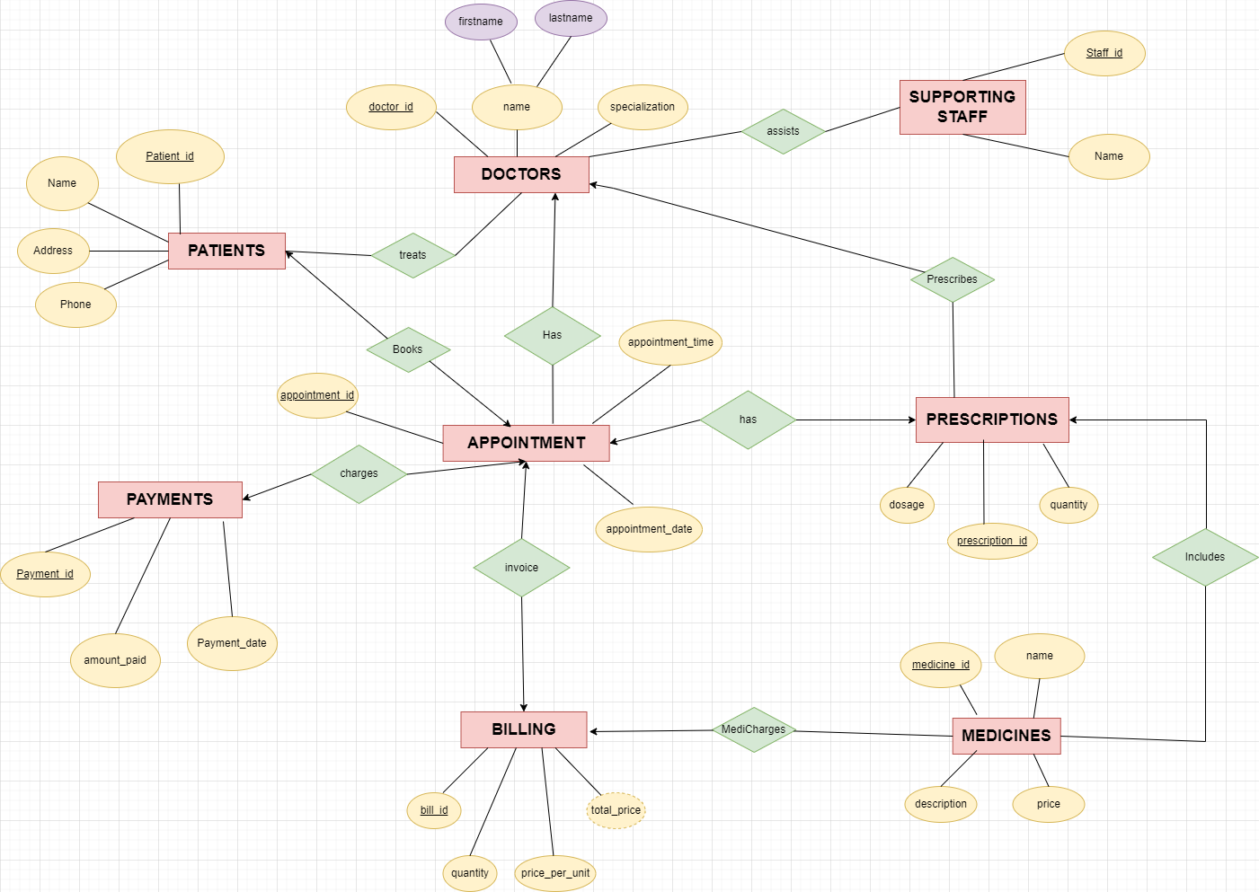
er diagram

Slide 5
Database Structure
ER Diagram & Assumptions:
Detailed entity-relationship diagram showcasing the relationship between doctors, patients, and other entities.
Relational Schema:
Conversion of ER diagram into a relational database schema.
Normalization:
Database normalization processes to ensure data integrity and efficiency.

Slide 6
SQL Statements and PL/SQL Code
Table Creation:
SQL scripts for creating tables like Doctors, Patients, Appointments, etc.
Insert Commands:
Sample SQL insertion commands for initial data setup.
PL/SQL Procedures:
Examples of PL/SQL procedures and functions for data manipulation and reporting.

Slide 7
System Usage Scenarios
Managing patient appointments, prescriptions, and billings efficiently.
Quick access to patient records and easy scheduling.
Customizable solutions for private healthcare practices to enhance operational efficiency.
In Hospitals
In Clinics,etc.

Slide 8
Conclusion
The Health Hub Doctor-Patient Management system is a cutting-edge solution designed to streamline the management of healthcare services, enhancing patient care and operational efficiency. It is adaptable to various healthcare settings, offering both standard and customized solutions to meet the diverse needs of modern healthcare providers. The implementation of this system not only improves the accuracy and efficiency of healthcare delivery but also offers strategic benefits in terms of operational cost reduction and enhanced patient satisfaction.

Slide 9
References
https://drive.google.com/file/d/1DABTfDAGois13Zw9hNT9rwY6HE66V-vu/view?usp=sharing
https://www.geeksforgeeks.org/how-to-design-a-database-for-healthcare-management-system/
https://medium.com/@apoorvchowdhry55/hospital-management-system-f21b978a1b8c
https://chat.openai.com/c/ee4fbf42-3ec8-41c6-b17b-bc29d408c58b
https://github.com/topics/hospital-management-system

